Slide 1

EDA on Airbnb Listings
Unlocking Insights from Rental Data
Presented by: [Raj]

Slide 2
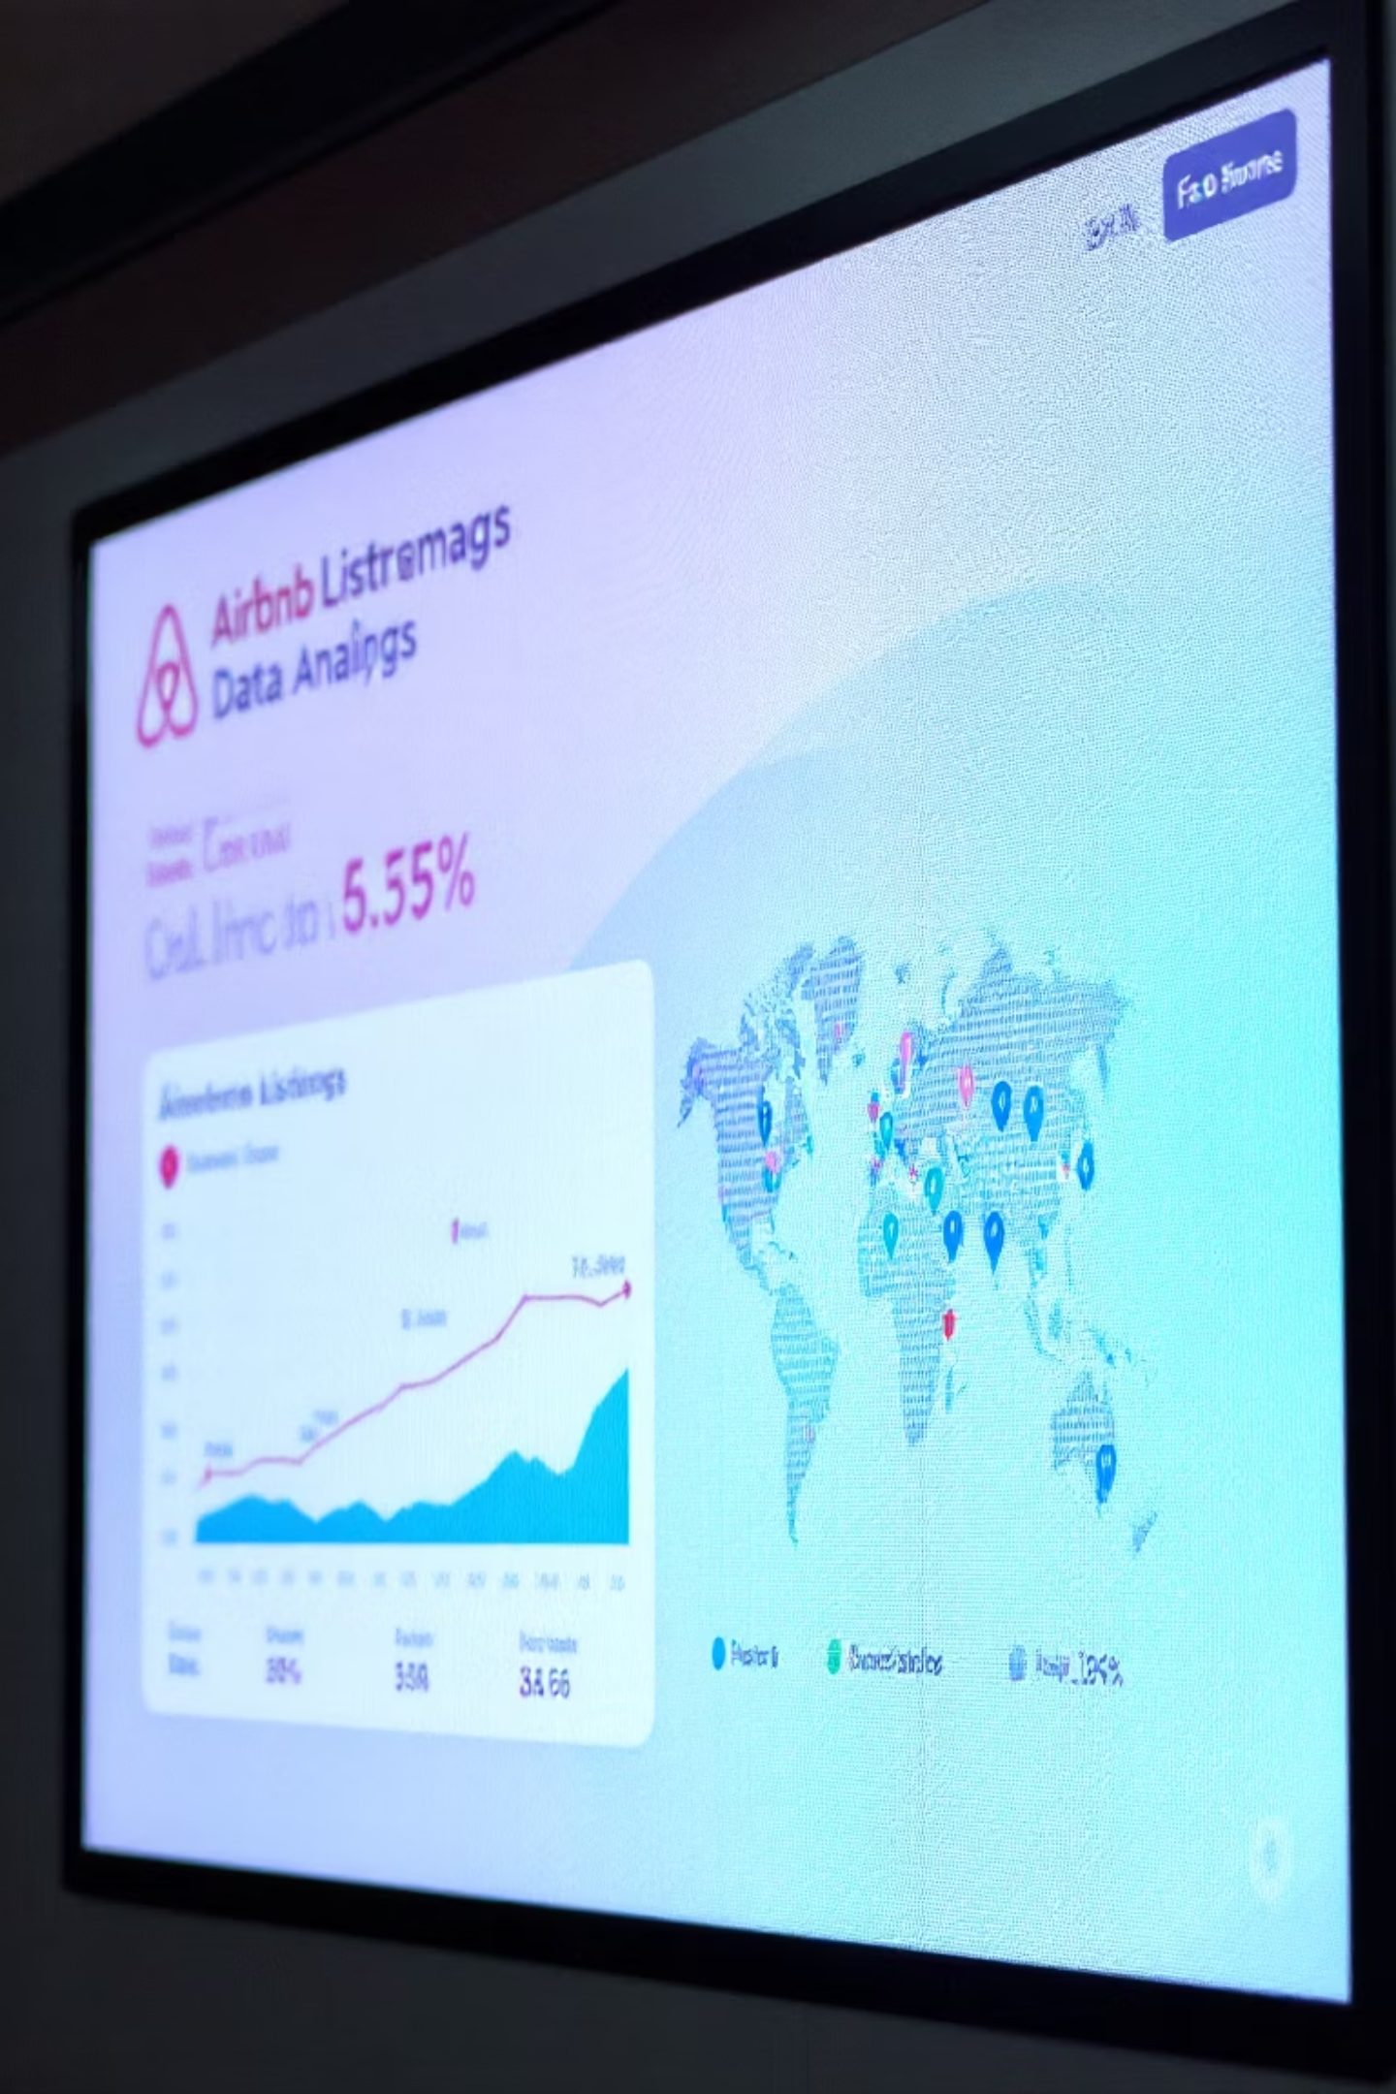
Introduction to the Project: Exploring Airbnb Data
Exploratory Data Analysis (EDA) is vital for understanding complex datasets. It involves summarizing main characteristics, visualizing patterns, detecting anomalies, and testing assumptions to gain initial insights.
In this project, we apply EDA to a rich dataset of Airbnb listings. Our goal is to uncover hidden trends, understand host and property dynamics, and identify key factors influencing pricing and availability.

Slide 3

Tools and Technologies
Our Exploratory Data Analysis of Airbnb listings leverages a powerful suite of tools and technologies, primarily rooted in the Python ecosystem. This combination allows for efficient data handling, robust analysis, and insightful visualizations.
Python: The foundational language, offering flexibility and extensive libraries for data science.
NumPy: Essential for high-performance numerical computing and efficient array operations.
Pandas: Crucial for data manipulation and analysis, utilizing DataFrames to clean and transform our Airbnb dataset.
Matplotlib & Seaborn: Employed for creating compelling static and interactive data visualizations, uncovering patterns and trends.
Jupyter Notebooks: The interactive environment where all analysis and visualizations were developed and documented.

Slide 4
Project Working: Our EDA Workflow
Our exploratory data analysis followed a structured workflow, designed to extract maximum value from the raw Airbnb listing data. Each phase built upon the last, progressively refining our understanding.
Data Collection & Loading
1
Acquired comprehensive Airbnb listing data, focusing on key metropolitan areas. Utilized Pandas for efficient loading and initial inspection of the dataset structure.
2
Data Cleaning & Preprocessing
Addressed missing values, identified and handled outliers, converted data types, and standardized formats to ensure data quality and consistency for analysis.
Exploratory Data Analysis
3
Conducted in-depth analysis using Matplotlib and Seaborn to visualize distributions, identify correlations, and understand geographical pricing patterns and property type prevalence.
4
Feature Engineering
Created new, more insightful features from existing ones, such as 'price per person' or 'host response rate category', to enhance the depth of our analysis.
Insights & Interpretation
5
Synthesized findings into actionable insights, identifying key drivers of listing success and areas for potential improvement or further investigation, forming the basis for our conclusions.

Slide 5
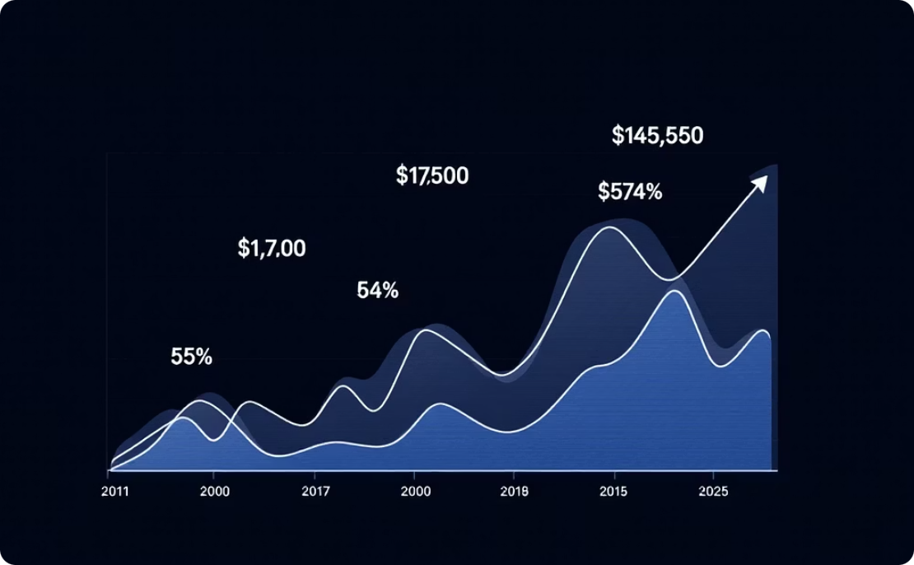
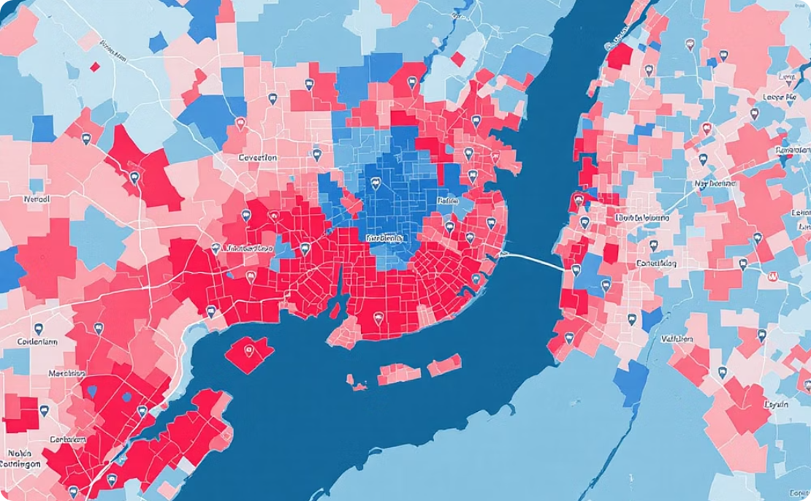

Applications & Impact of Our EDA
Our Exploratory Data Analysis provides valuable insights that can be directly applied by various stakeholders to make informed decisions within the Airbnb ecosystem. From individual hosts to larger investment firms, the findings offer practical guidance.
Optimized Pricing Strategies
Identifying High-Demand Neighborhoods
Enhancing Guest Experience
Hosts can leverage our analysis of seasonal trends, neighborhood demand, and amenity impact to set competitive and profitable prices for their listings, maximizing occupancy and revenue.
By understanding correlations between amenities, host response times, and guest reviews, hosts can strategically improve their offerings to attract more bookings and secure higher ratings.
Our geographical analysis pinpoints areas with high booking rates and premium pricing, offering crucial intelligence for potential investors or hosts looking to expand their portfolio.

Slide 6




Challenges & Solutions in EDA
Navigating the complexities of real-world data is integral to any robust EDA process. During our analysis of Airbnb listings, we encountered several common data challenges, each requiring specific strategies to overcome.
Missing Data Imputation
Outliers and Anomalies
A significant portion of critical fields, such as 'reviews per month' or 'host response rate', contained missing values. We employed various imputation techniques, including mean/median imputation and predictive modeling, to preserve data integrity.
Identifying and handling extreme outliers in price, minimum nights, or availability was crucial. Robust statistical methods and visualization were used to detect these anomalies without losing valuable information, preventing skewed analysis.
Text Data Interpretation
Geospatial Data Complexity
Analyzing textual data like listing descriptions and reviews posed challenges due to unstructured nature. Techniques such as tokenization, sentiment analysis, and keyword extraction were applied to derive meaningful insights.
Leveraging geographical coordinates for neighborhood analysis and heatmaps required careful handling. We transformed raw coordinates into meaningful spatial features and integrated external demographic data for richer context.

Slide 7




Future Scope: Expanding Our EDA Horizons
Building on the foundational insights from our initial EDA, there are several exciting avenues for further exploration and enhancement to deepen our understanding of the Airbnb market.
Predictive Modeling
Advanced Geospatial Analysis
Develop machine learning models to forecast listing prices, occupancy rates, or optimal host strategies based on identified key features and market dynamics.
Integrate more granular location-based data, such as local amenities, public transport access, and demographic shifts, to refine neighborhood value assessments.
Enhanced Sentiment Analysis
External Data Integration
Utilize advanced NLP techniques to extract deeper insights from guest reviews and host communications, identifying nuanced satisfaction drivers and areas for improvement.
Incorporate external macroeconomic indicators, tourism statistics, and local event calendars to contextualize Airbnb trends and identify broader market influences.

Slide 8
Key Takeaways & Conclusion
Our comprehensive EDA on Airbnb listings has not only provided deep insights into market dynamics but also underscored the power of data-driven decision-making. Here are the core conclusions from our analysis:
Unveiling Market Trends
Actionable Insights for Stakeholders
Robust Data Handling & Methodology
We successfully identified significant seasonal pricing fluctuations, high-demand geographical areas, and the direct impact of amenities on listing appeal and profitability.
The analysis yielded practical strategies for hosts to optimize pricing and enhance guest experience, and for investors to pinpoint lucrative opportunities within the Airbnb ecosystem.
Our project demonstrated effective strategies for tackling real-world data challenges, including missing data, outliers, and complex geospatial and text analysis, ensuring the reliability of our findings.
This EDA forms a strong foundation for future predictive modeling and advanced market analysis, highlighting the continuous potential for data to transform business strategies.

Slide 9



Thank You!
We hope this presentation provided valuable insights into the power of Exploratory Data Analysis for Airbnb listings.

